Slide 1
Descriptive Statistics

Slide 2
Descriptive vs Inferential Statistics
Statistics is often separated into two categories: Descriptive and Inferential
Descriptive statistics seeks to…describe or summarize data in a clear, concise, and standardized way, allowing us to quickly understand the fundamental characteristics of a data set, as well as to make simple comparisons between data sets
Examples of descriptive statistics include averages, ranges, variance, etc.
Inferential statistics seeks to…infer the properties of a population or alternative sample from a given sample.
Examples of inferential statistics include hypothesis testing, confidence intervals, regression analysis, etc.

Slide 3
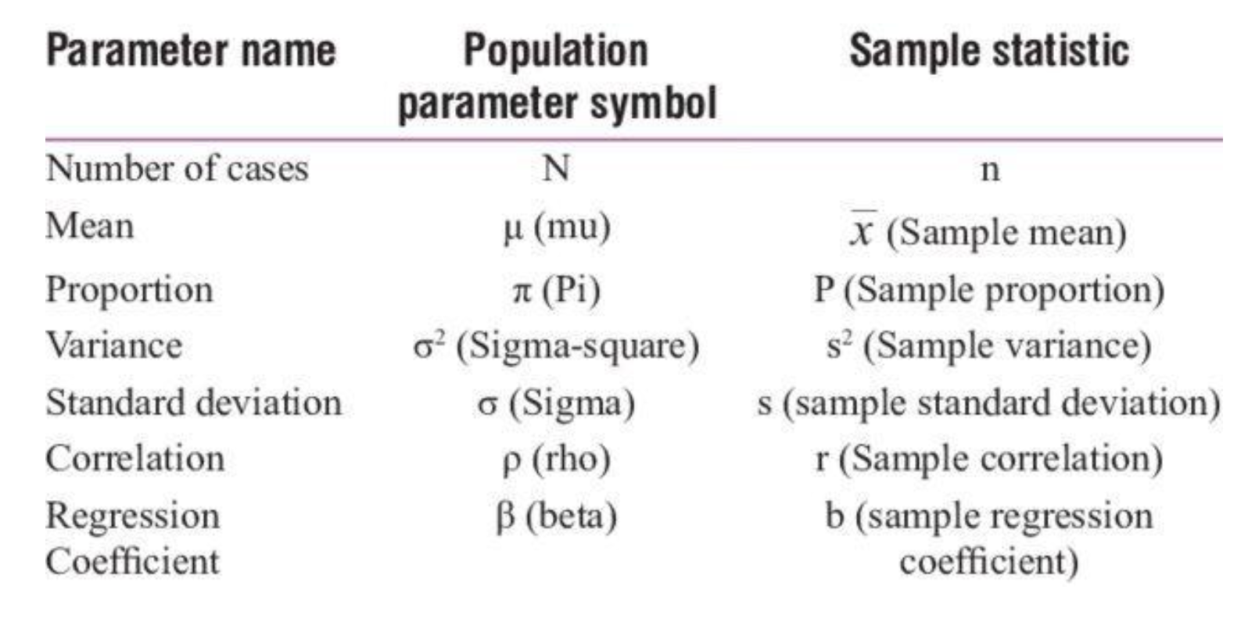

Slide 4
Descriptive Statistics
Main types of descriptive statistics:
Measures of central tendency
Measures of spread / dispersion
Distribution / Shape
Measures of Relation (if more than one series)

Slide 5
Measures of Central Tendency
Commonly referred to as “averages”
Used to give an idea of the “middle” of the data
We’re going to cover:
Arithmetic mean
Geometric mean
Median
Mode

Slide 6
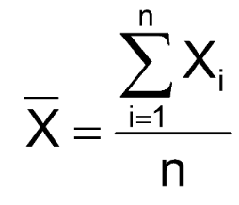
Measures of Central Tendency: Arithmetic Mean
There are many types of “average”.
The most common is the “arithmetic mean”, often just called the “mean”
Add up all the numbers, then divide by the number of numbers in the series
If we have a series of five numbers {1, 2, 3, 4, 5}
1 + 2 + 3 + 4 + 5 = 15
15 / 5 = 3
Warning: The arithmetic mean is sensitive to extreme values

Slide 7
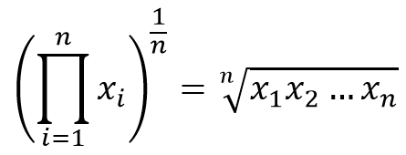
Measures of Central Tendency: Geometric Mean
The geometric mean is used for exponential and/or compounding series
Multiply each number in a series together, then take the n’th root of that product, where n is the number of numbers in our series
The n’th root of x is the number y such that raising y^n = x
Given {1, 2, 4, 8, 16}, we multiply 1 x 2 x 4 x 8 x 16 = 1024
1024^(⅕) = 4

Slide 8
Measures of Central Tendency: Geometric Mean Rate of Return
Geometric Rate of Return = [(1 + R1) x (1 + R2) x (1 + Rn)]^1/n - 1
Period | Starting Amount | Interest Rate | Ending Amount
1 | 100,000 | .05 | 105,000
2 | 105,000 | .08 | 113,400
3 | 113,400 | .02 | 115,668
4 | 115,668 | .09 | 126,078
5 | 126,078 | .15 | 144,989
6 | 144,989 | .09 | 158,038
7 | 158,038 | .11 | 175,422
Arithmetic Mean:
8.42*
Geometric Mean: 8.36
@ 8.42% = $176,102
@ 8.36% =
$175,421
AM off by $794
GM off by $1

Slide 9
Measures of Central Tendency: Geometric Mean Rate of Return
Period 1: $100,000, then a 50% decline
Period 2: $50,000, then a 100% increase
Period 3: $100,000
Arithmetic mean rate of return = (-.5 + 1 )/ 2
= 25%
Geometric Rate of Return = [(1 + R1) x (1 + R2) x (1 + Rn)]^1/n - 1
[(1 + -0.5) X (1 + 1)]^½ -1 = [(0.5) * (2)]^½ -1
=0%

Slide 10
Measures of Central Tendency: Median
The median is the number in the middle of an ordered series
50% of the data fall above the median, 50% fall below the median
Position of median = (n + 1) / 2, if series is ordered
If we have the series {1, 3, 5, 2, 4}
First we order it {1, 2, 3, 4, 5}
The number in the middle is the median, so 3
What if there is an even numbered series?
{1, 2, 3, 4, 5, 6}
The median is the mean of the middle two numbers, so (3 + 4) / 2, which is 3.5
Unlike the mean, the median is not sensitive to extreme values

Slide 11
Mean vs Median and Extreme Values
The mean is the most commonly reported average and should generally be used when sensitivity to extreme values isn’t an issue.
Otherwise, use the median or report both
Incomes = [20000, 35000, 60000, 80000, 110000]
Mean = 61,000
Median = 60,000
Incomes = [20000, 35000, 60000, 80000, 900000]
Mean = 219,000
Median = 60,000

Slide 12
Measures of Central Tendency: Mode
The mode is the most commonly occurring number in a series
If we have {1, 2, 2, 4, 5}, 2 occurs twice and the others only occur once, so the mode is 2
If we have {1, 2, 3, 4, 5}, all numbers occur equally so there is no mode.
If we have {1, 1, 3, 3, 5}, we have two modes, aka the data is bimodal, and our answer would be both 1 and 3
The mode is also not sensitive to extreme values

Slide 13
Measures of Dispersion
Measures of dispersion tell us how spread out the data are
Between knowing where the data is centered (averages) and how the data are spread out from the mean, we can get an even better idea of our data’s properties
We’re going to cover
Range
Variance
Standard deviation
Median Absolute Deviaton
Coefficient of variation

Slide 14
Measures of Dispersion: Range
Range = Largest Value - Smallest Value
X = {2, 6, 3, 9, 3}
Max = 9
Min = 2
Range = 9 - 2 = 7
Range is sensitive to outliers

Slide 15
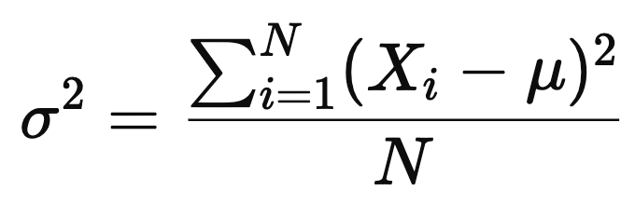
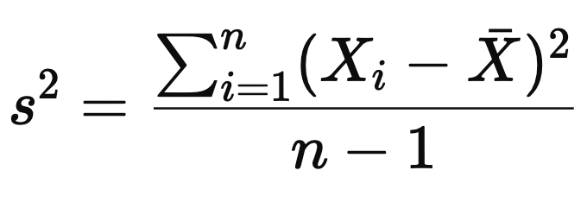
Measures of Dispersion: Variance
Variance is the average squared distance the numbers in a series are away from the series mean
Variance is calculated by
Calculating the series mean
Subtracting the mean from each value in the series
Squaring each difference
Adding up all those squared differences
Dividing the total by either A) the population size (N) for population variance, or B) the sample size minus one (n -1) for sample variance
Notes:
https://en.wikipedia.org/wiki/Bessel%27s_correction

Slide 16
Measures of Dispersion: Variance
If our series is {1, 2, 3, 4, 5}, our mean is 3
(1-3)^2 + (2-3)^2 + (3-3)^2 + (4-3)^2 + (5-3)^2 =
-2^2 + -1^2 + 0^2 + 1^2 + 2^2 =
4 + 1 + 0 + 1 + 4 = 10
10 / 5 (since there are 5 numbers in the series) = 2

Slide 17
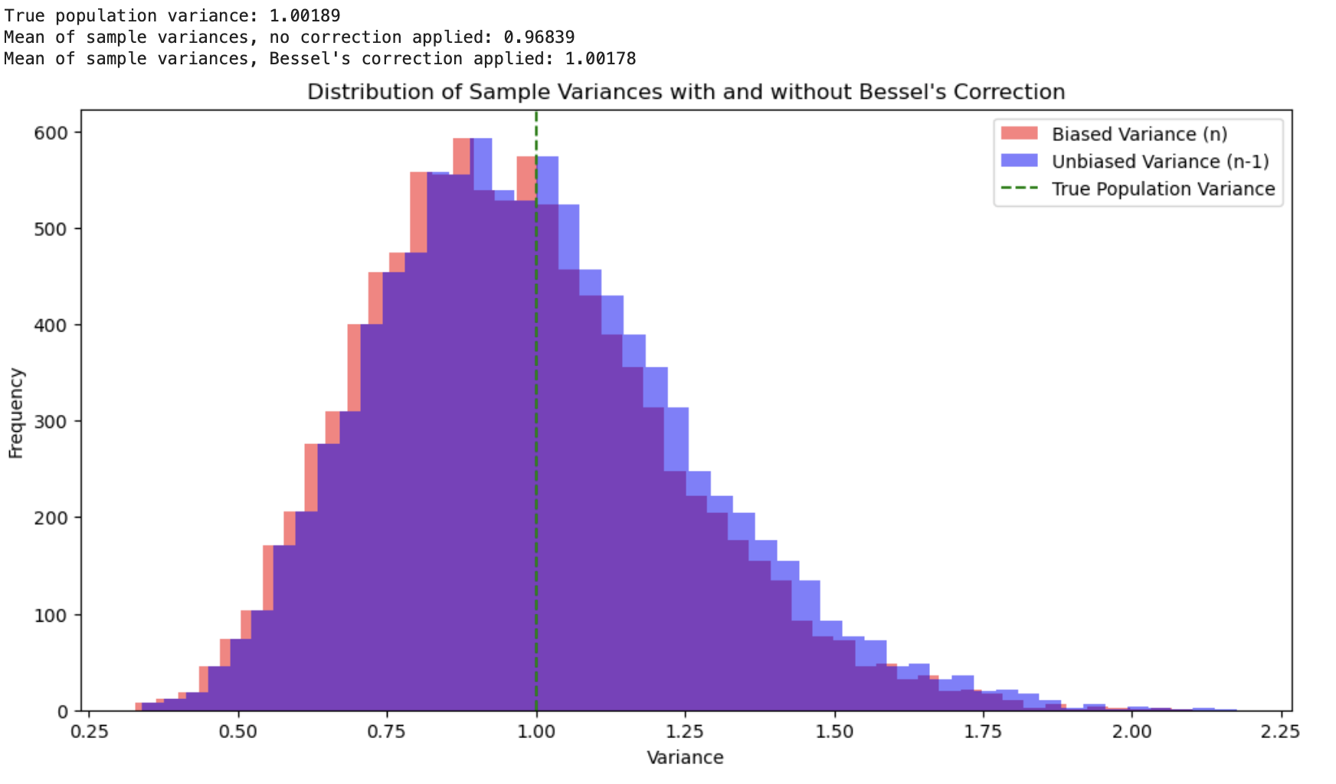
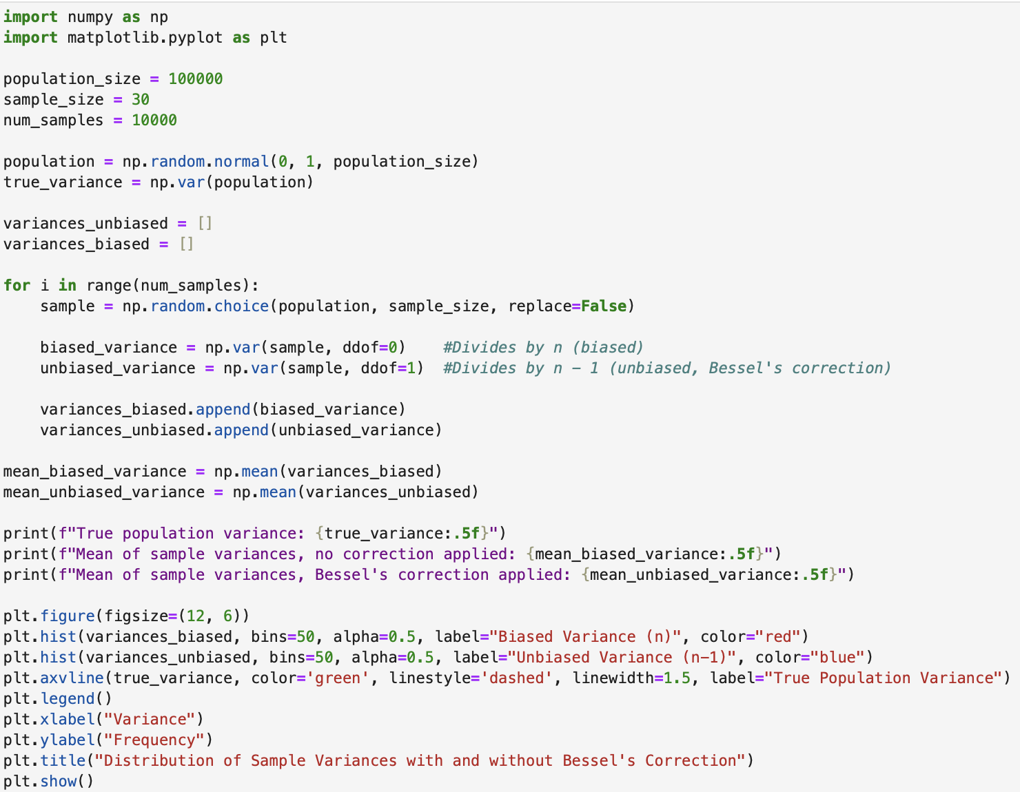
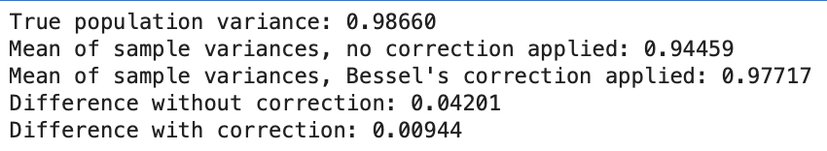
Bessel’s Correction
Notes:
https://mathcenter.oxford.emory.edu/site/math117/besselCorrection/

Slide 18
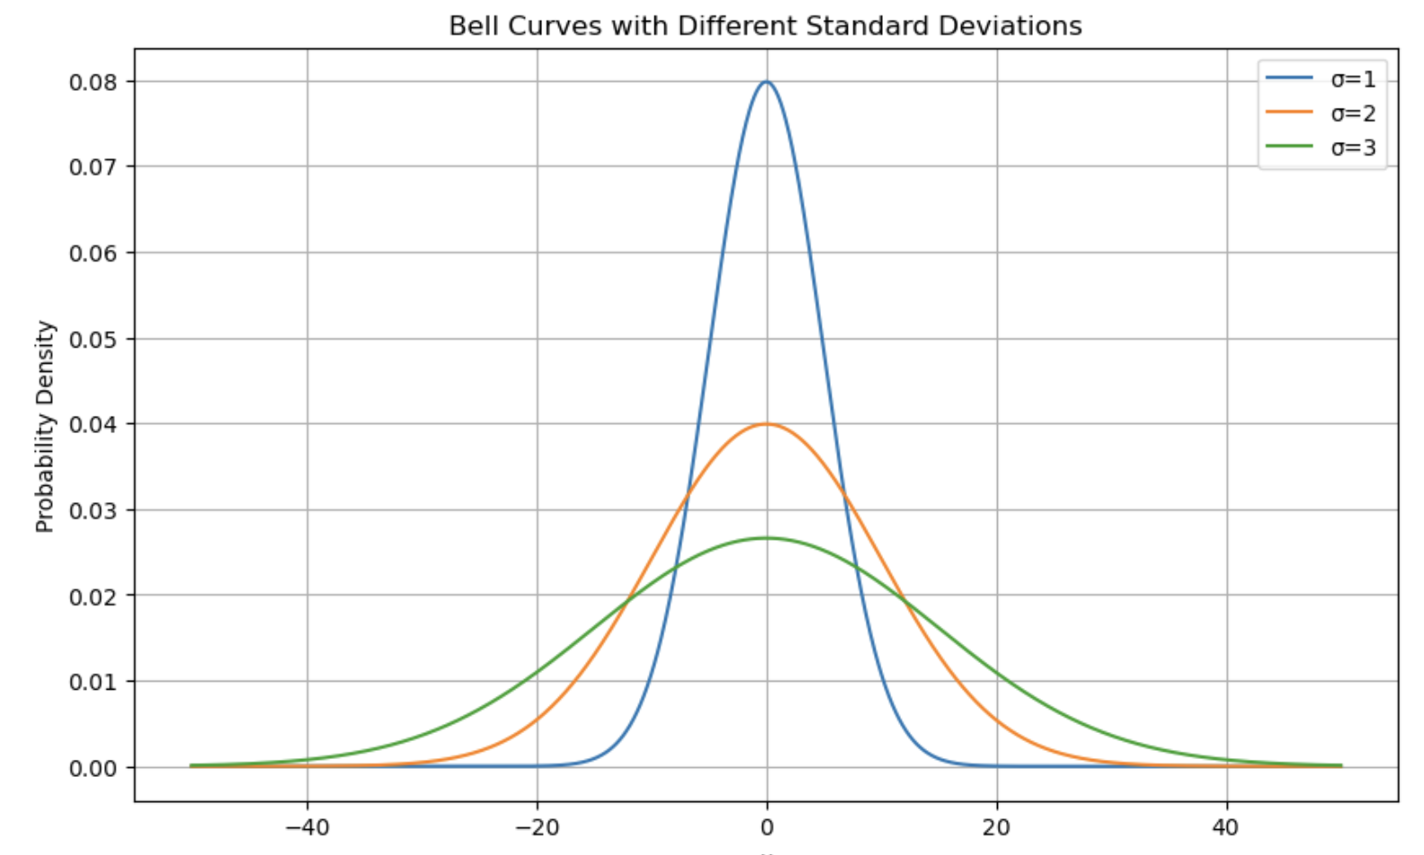
Measures of Dispersion: Standard Deviation
Tells us the average distance each datapoint is from the mean
Just take the square root of variance!
Variance of {1, 2, 3, 4, 5} = 2
=sqrt(2) = 1.44
So the standard deviation of the series is 1.44

Slide 19
Measures of Dispersion: Standard Deviation
With such a simple transformation, isn’t standard deviation telling us basically the same thing as variance?
Standard deviation is generally more useful than variance since it is measured in the same units as the series
If we have a series of bins of apples each containing {1, 2, 3, 4, 5} apples, the variance of 2 is in terms of “apples squared”
Converting to standard deviation, by taking the square root, turns the measure into “apples”, with our series having a standard deviation of 1.44 apples

Slide 20
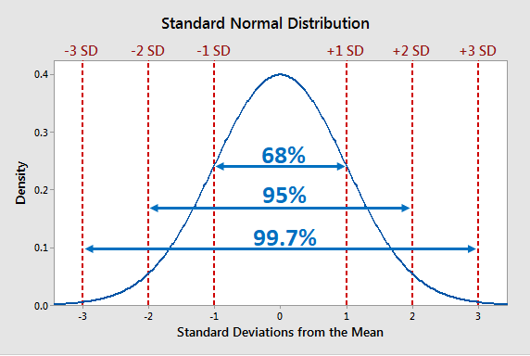
The Empirical Rule

Slide 21
Median Absolute Deviation
Measures variability in a way less sensitive to outliers and skewness.
Quantifies dispersion around the median, instead of the mean
MAD = median(|Xi - median(X)|)
x = [3, 6, 8, 10, 15]
Median = 8
{|3 -8|, |6 - 8|, |8 -8|, |10 - 8|, |15 - 8|}
{5, 2, 0, 2, 7]
Order the series!
[0, 2, 2, 5, 7]
Take the median
MAD = 2

Slide 22
Coefficient of Variation
Used for comparing the relative variability / volatility of datasets with different units or scales.
CV = Standard Deviation / Mean
Stock A ROI: Mean 12%, Standard Deviation 4%, CV = 4/12 = 33.3%
Stock B ROI: Mean 8%, Standard Deviation 3%, CV = 3/8 = 37.5%
Stock B is more volatile than stock A

Slide 23
In Excel
Arithmetic Mean | =average()
Geometric Mean | =geomean()
Median | =median()
Mode | =mode.sngl() for single, =mode.mult for multimodal
Variance | =var.p() for population and =var.s() for sample
Standard Deviation | =stdev.p() for population and stdev.s() for a sample

Slide 24
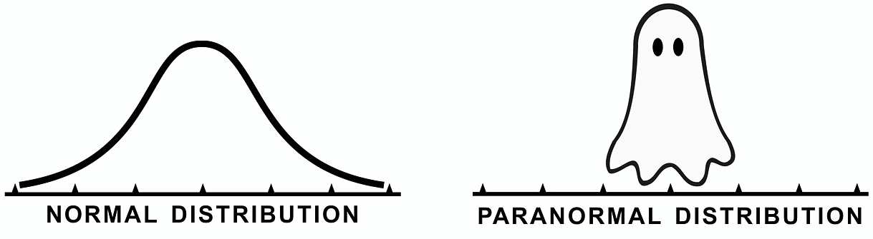
Distribution / Shape

Slide 25
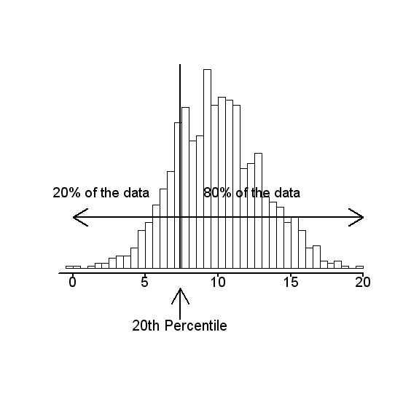
Percentiles
If a number is in the P’th percentile, it is greater than P% of the values
A number in the 90th percentile is larger than 90% of the other numbers in a series
To find what number is at the P’th percentile, use the formula:
Value at which P % of the data are below = P(n + 1)/100

Slide 26
Percentiles
Finding percentiles
Scores = {80,77,76,82,89,84,81,85,87,75,92,75,90,87,95,81,96,81,95,99,75}
Sort from lowest to highest
Scores = {75,75,75,76,77,80,81,81,81,82,84,85,87,87,89,90,92,95,95,96,99}
Find the 20th percentile (n = 21)
P(n + 1)/100
20 * (21 + 1) / 100 = 20 * 22 / 100 = 4.4
4.4th place…round up to 5th place so that value is the value just above P percent of the data
Scores = {75,75,75,76,77,80,81,81,81,82,84,85,87,87,89,90,92,95,95,96,99}

Slide 27
Quartiles, Deciles, & Quantiles
Quartiles are the 25th, 50th, and 75th percentiles of data and divide the data into 4 segments
Quartiles are found by ordering your data and using the formulas
1st quartile = ¼(n + 1)th term
2nd quartile = ½(n + 1)th term = Median
3rd quartile = ¾(n + 1)th term
Interquartile range measures spread between 25th and 75th percentiles
IQR = 3rd Quartile - 1st Quartile
Deciles divide the data into 10 segments (10th percentile, 30th percentile, etc.)
Quantiles are the same as quartiles, just with numbers other than 25, 50, and 75

Slide 28
Frequency Distributions
Frequency distributions are tables or graphs that show the number of observations within a given range / interval or category
Grade | Frequency | Relative Frequency | Cumulative Frequency (Ascending)
A | 3 | 3 / 12 = .25 | 1
B | 5 | 5 / 12 = .42 | .75
C | 2 | 2 / 12 = .17 | .33
D | 1 | 1 / 12 = .08 | .16
F | 1 | 1 / 12 = .08 | .08

Slide 29
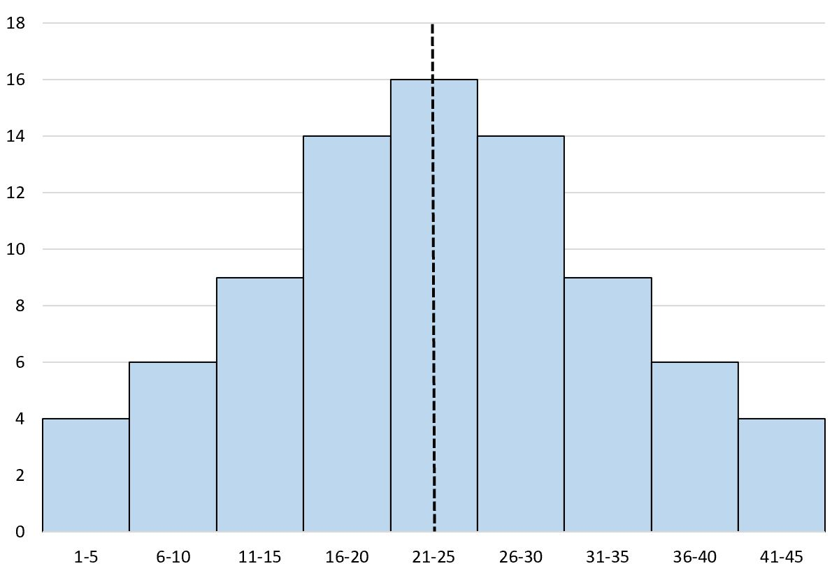
Histograms
Data is broken into evenly sized ranges
Similar to bar chart, but numerical rather than categorical
The height of the bar at each range corresponds to the quantity of values in that bar’s corresponding range
For example, in the histogram to the right, there are 6 instances where the value falls between 6 and 10, as well as 36 and 40

Slide 30
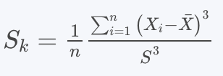
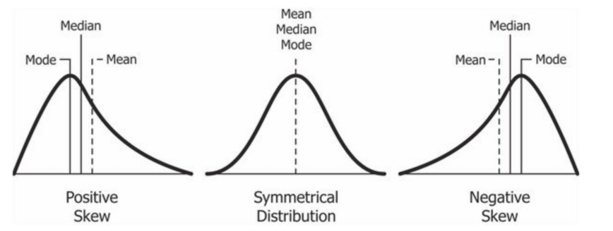
Skewness

Slide 31
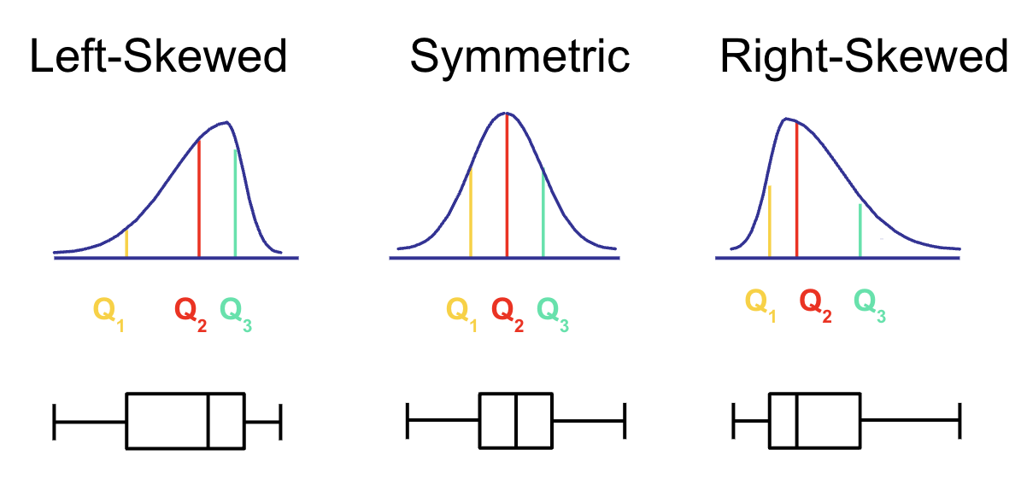

Slide 32
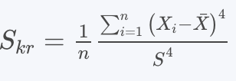
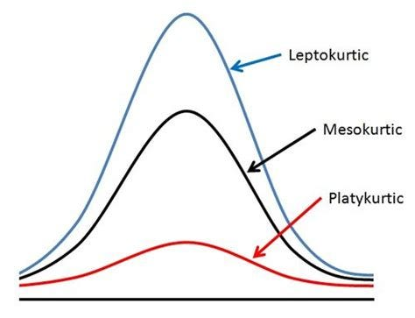
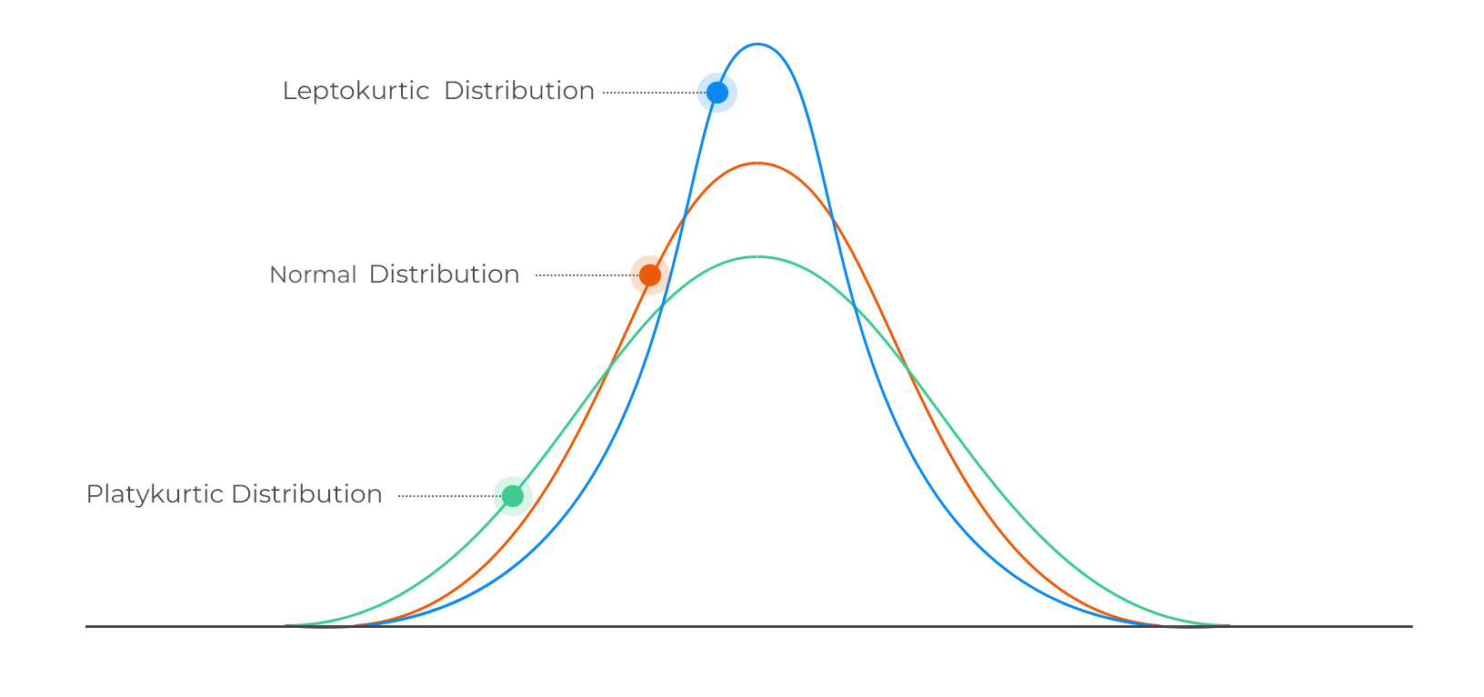
Kurtosis
Kurtosis measures “peakedness” and points to likelihood of extreme values

Slide 33
Uses of Kurtosis
Detecting outliers: High kurtosis suggests extreme outliers are more likely (fatter tails)
Risk: High kurtosis suggests extreme events are more likely
Comparing distributions - relative to normal distribution
Checking certain statistical / distributional assumptions*
Kurtosis >3 suggests heavier tails, a shaper peak, and potential for outliers
Kurtosis <3 suggest lighter tails, a flatter peak, and less potential for outliers
Kurtosis = 3 suggests distribution similar to normal distribution

Slide 34
Measures Of Association
Measures of Association tell us how two (or more) variables relate to one another. We’ll cover:
Covariance
Correlation

Slide 35


Measures of Association: Covariance
Steps:
Calculate means of x and y
Subtract the mean of each variable from each observation
Multiply each x-xbar by each y-ybar
Sum the products
Divide by the number of observations if population, or n-1 if a sample

Slide 36
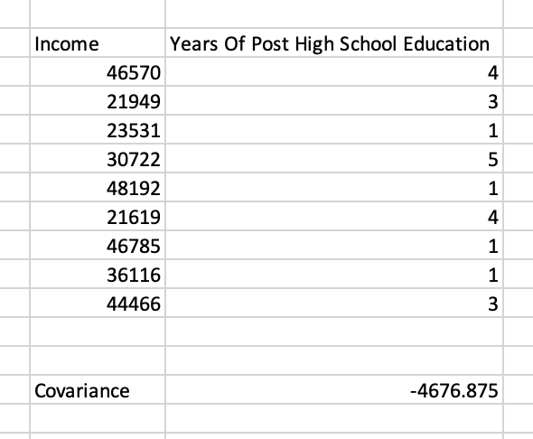
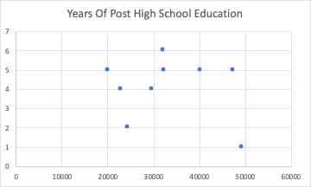
Interpreting Covariance
Units don’t make sense intuitively
Both income and education information combined into a single variable?
Is a covariance of -4,676 a lot? Who knows?!
Positive means as one variable increases, the other usually does too
Negative means as one variable increases, the other usually falls
Zero means there is no linear relationship between the variables
Correlation is more useful

Slide 37


Measures of Association: Correlation
Unit free means it is not measured in terms of something else
Can be compared between samples and variables
Ranges between -1 to 1
0 means no correlation, 1 means perfect positive linear correlation, -1 means perfect negative linear correlation
S_{x} is standard deviation of x,
S_{y} is the standard deviation of y
s_{xy} is the sample covariance

Slide 38
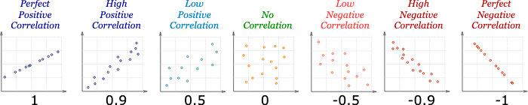
Correlation Coefficient
Covariance(xy) / Stdev(x) * Stdev(y)
Ranges between -1 to 1
0 = No linear correlation
-1 = Perfect negative linear correlation
+1 = Perfect positive linear correlation
Can be compared between samples and variables

Slide 39
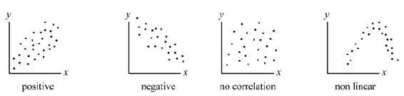
Correlation Scatter Plots
Correlation coefficient cannot account for non-linear relationships

Slide 40
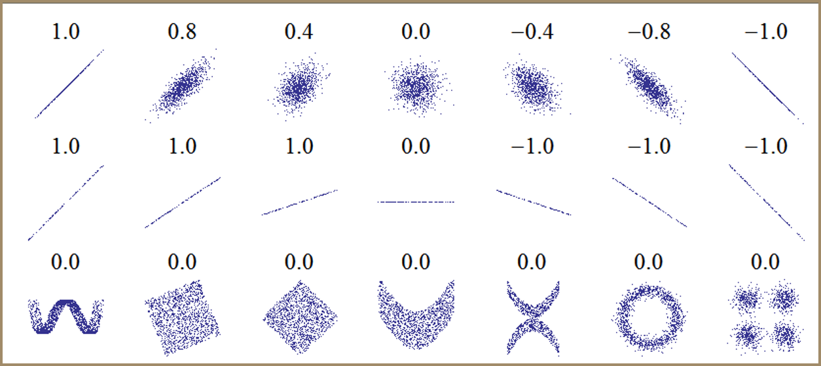

Slide 41
Covariance and Correlation in Excel
=covariance.s(x values, y values) for sample
=covariance.p(x values, y values) for population
= correl(x values, y values)

Slide 42
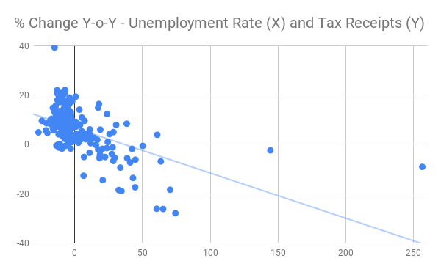
Graphing Two Variables At Once
Scatter plot: Graph plotting each observation on 2D “Cartesian Plane”

Slide 43
Correlation =/= Causation
Correlation does not equal causation
People attribute causality to concurrent phenomena
Resist the urge
Without theory / subject matter specifics, causality cannot be inferred
Or can it...

Slide 44
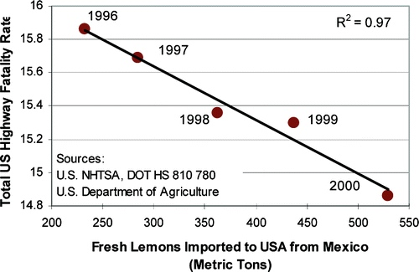
Causality and Spurious Correlation
Importing lemons from Mexico saves American lives on the highway!
Two sets of data may resemble one another for lots of reasons
Often hard to resist attributing causality
People will find patterns even if they aren't there!

Slide 45
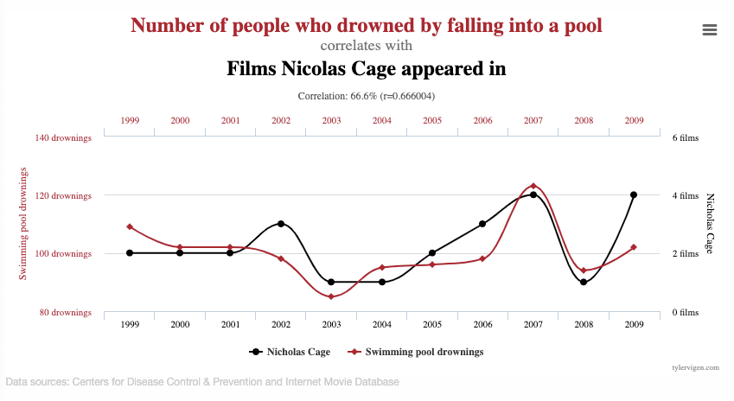

Slide 46
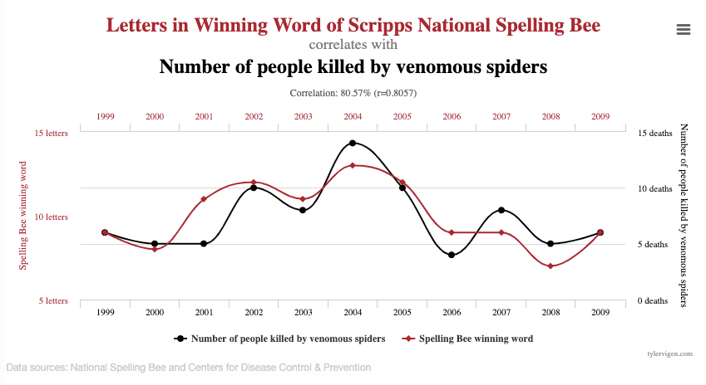

Slide 47
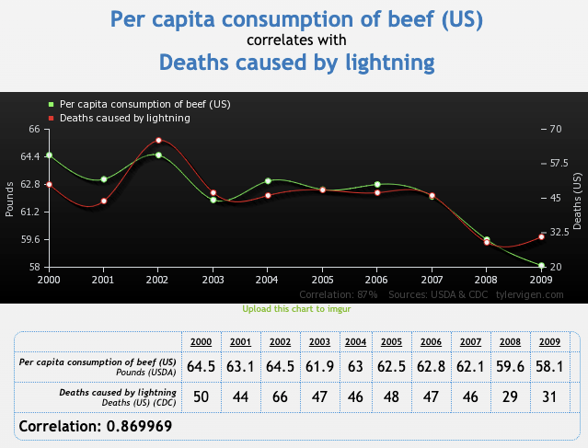

Slide 48
Causal Inference
There are many statistical methods used to determine causality
Among the most popular are randomized control trials, regression discontinuity designs and difference-in-differences methods
More on this later

Slide 49
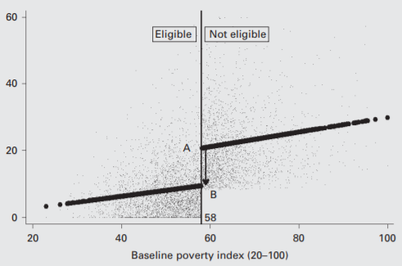
Regression Discontinuity
Find instances where cutoffs are discrete
Examples
1) Social programs that have income cutoffs
2) Scholarships / admissions with GPA / ACT cutoffs,

Slide 50
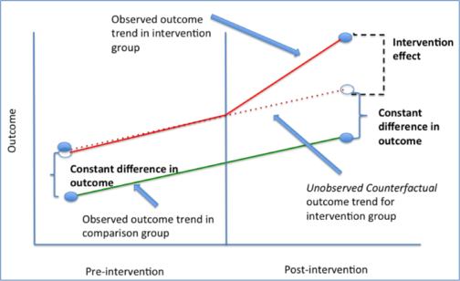
Difference in Differences
One group changes post intervention, the other doesn’t

Slide 51
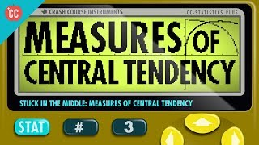

Slide 52
